Slide 1

BDM2053 – Big Data Algorithms and Statistics
Video Games Trend Analysis (Recommendation System)
April 20, 2023
Submitted to :
Prof. Dhruwal Shah
Submitted by Group 12 : Auradee Castro Bhumika Rajendra Babu Miraj Sinya Olivia Deguit Roger Mais

Slide 2
Case Background
Client wants to venture into the Video Game Industry and has requested our assistance in understanding the market, and at the same time to develop a recommendation system for video game titles based on user preferences.
Dataset containing information of video game such as sales (in units), genre, release year, platform, critic score and user scores, is accessible to the public on VGChartz, which is used for cross-validating the data collected from Kaggle.
Deliverables to the client:
Recommendation Model that provides suggestions for the video game titles to users based on the game title and platform (optional) as input
Market Analysis Report that presents an analysis of the Video Game Industry trend using available data up to the year 2020
Regional Sales
Genre
Platform
Notes:
Video Game Sales with Ratings | Kaggle

Slide 3












Project Breakdown
Milestone 1
Project
Details & Design
Milestone 2
Data
Acquisition
Milestone 3
Data Analysis &
Visualization
Milestone 4
Model Creation &
Evaluation
Milestone 5
Project Presentation
& Report
Activities
Identifying Business Problem
Breaking down business problem into Key Questions to be answered
Sourcing relevant data to address the identified business problem
Cross-validating dataset
Data Sources used:
Exploratory Data Analysis
Evaluating Data Distribution
Data Preprocessing
Market Trend Analysis
Tools used:
Model development for video game recommendation
Assessment of user efficiency
Tools used:
Preparation for final project report and presentation
Tools used:
Timeline
Week 1
Week 2
Week 3
Week 4
Week 5
Milestone 1
Milestone 2
Milestone 3
Milestone 4
Milestone 5
Project Schedule: March 16, 2023, to April 20, 2023

Slide 4
Discussion on Project Details & Design
Breaking down the business problem into key questions
Key Questions
Complexities
Which tool best meets the requirements of the request?
Choosing the appropriate visualization tool, such as Excel, Python, or Power BI, that can handle the data size effectively
Identifying relevant features to be taken into consideration to carry out Descriptive Analysis
Market Analysis
What information is relevant to understand the trend?
What is the coverage of data in terms of Games’ release year?
Client’s
Request
Which tool best meets the requirements of the request?
Deciding which model, whether it's supervised or unsupervised, generated the most relevant results
Identifying relevant features to be taken into consideration as input to develop the model
Determining the evaluation criteria for assessing the accuracy and/or efficiency of the model
Which model is the most appropriate?
Recommendation Model
What are the relevant features to consider?
How to assess the accuracy and/or user efficiency of the model?

Slide 5
Data Analysis & Visualization: Market Analysis (1/4)
Power BI as the main tool for the Market Analysis
Workflow
Details
Purpose
Power BI leveraged for data visualization through interactive dashboards to represent insights from the dataset
Power BI is a better tool than Excel in this scenario given its capability to effectively manage large datasets
Overview
Sales based on release year
Complexity
Dataset included only the cumulative sales figures until the year 2020 creating a roadblock to analyze yearly sales growth trend
Power BI
Region
Genre
Platform
Critic & User Scores
Breakdown
Resolution
Created 4 bins to group the data based on video game’s release years spanning from 1980 to 2020
1980 - 1990
1991 - 2000
2001 - 2010
2011 - 2020
Insight

Slide 6
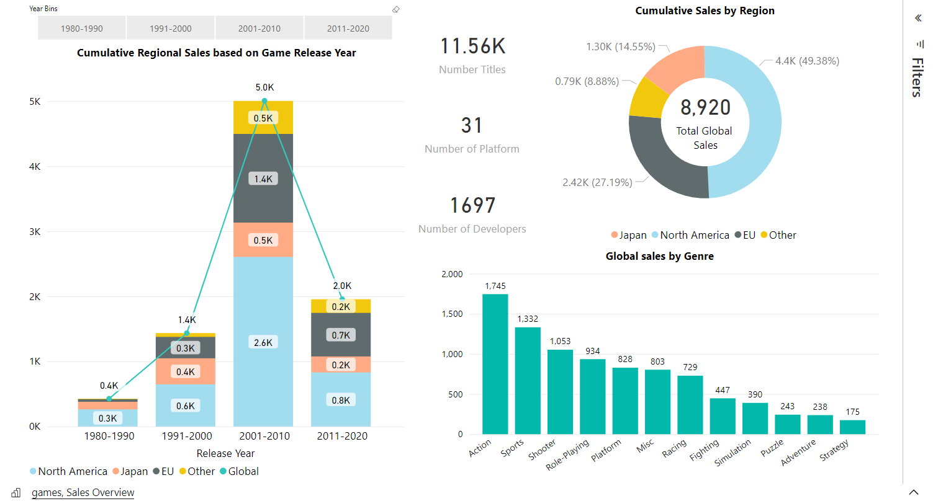
Data Analysis & Visualization: : Market Analysis (2/4)
North America accounted for almost half of the Global Sales until 2020 with games released between 2001-2010 having the highest sales amounting to 2.6B units
* Based on data till 2020
Sales Figures represented in Millions of Units (5.0K is equivalent to 5 Billion)
Others: Rest of the world, i.e., Africa, Asia excluding Japan, North America & Europe excluding the E.U.

Slide 7
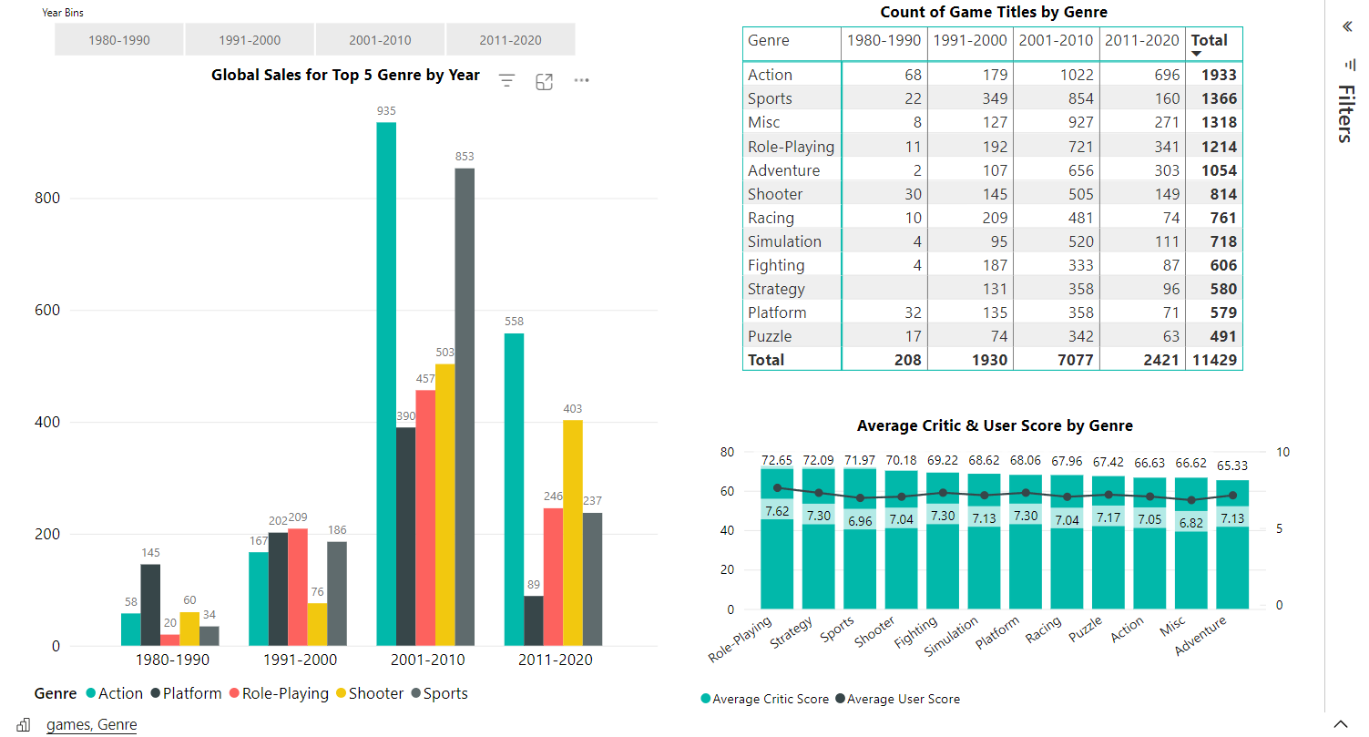
Data Analysis & Visualization: Market Analysis (3/4)
Transition from 2D graphics to 3D graphics in the late 90s resulted in exponential growth of the Action genre from 167M in the 90s to 935M in the 2000s
* Based on data till 2020
Sales Figures represented in Millions of Units (5.0K is equivalent to 5 Billion)

Slide 8
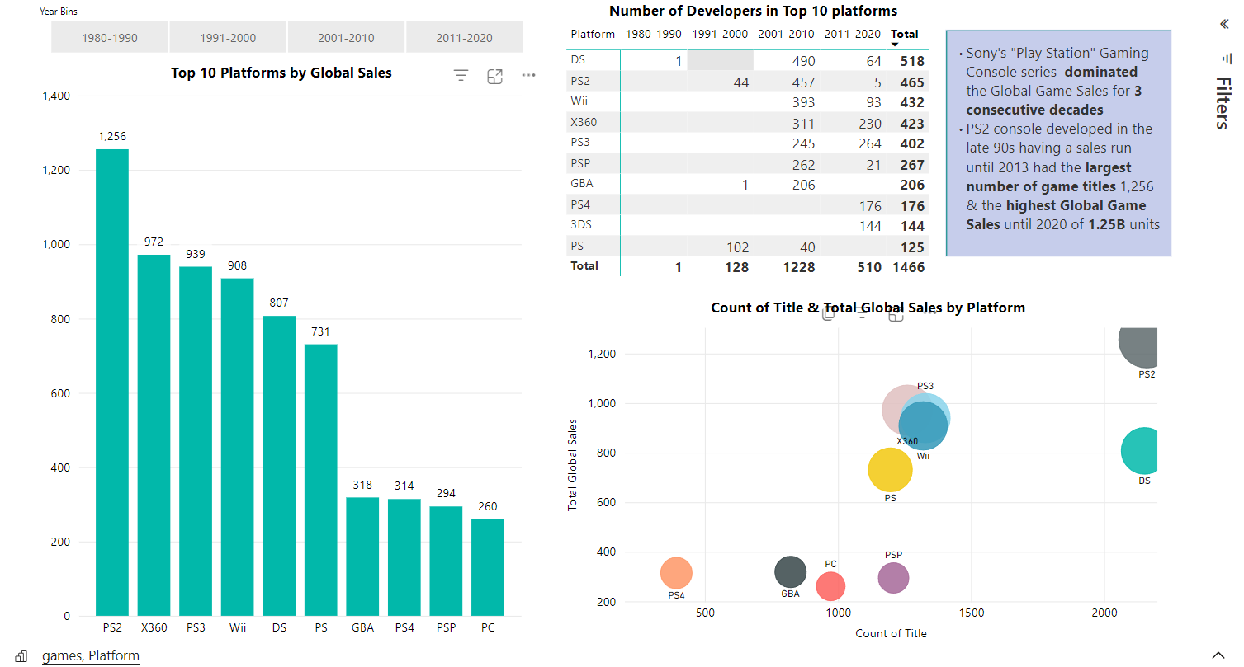
Data Analysis & Visualization: Market Analysis (4/4)
Dawn of Gaming Consoles with extensive graphics and 3D visualization capabilities in the late 90s contributed to proliferation of console sales making arcade games obsolete
* Based on data till 2020
Sales Figures represented in Millions of Units (5.0K is equivalent to 5 Billion)

Slide 9




Data Acquisition & Exploration
Python as the main tool for data exploration and data preprocessing
Data Flow
Details
Description
Sourcing dataset from Kaggle that met the requirements of the project
Data Acquisition
Data Exploration
Kaggle
VGChartz
Loading CSV data file into Python using Pandas
Conducting exploratory data analysis and data preprocessing
Python
Raw Data in CSV Format
Pandas,
Matplot, Seaborn
Pandas, Numpy,
Sklearn
Getting clean data for model development
Features:
Title, Release Year, Genre, Platform, Sales by Region, User & Critic Scores, Rating, etc.
Complexity
Acquiring dataset with relevant features to answer the key questions
Handling missing data from the dataset
Exploratory Data Analysis
Data
Preprocessing
Clean Data
Resolution
Dropped unnecessary records with missing values
Replaced null values with the imputed data from the respective columns

Slide 10
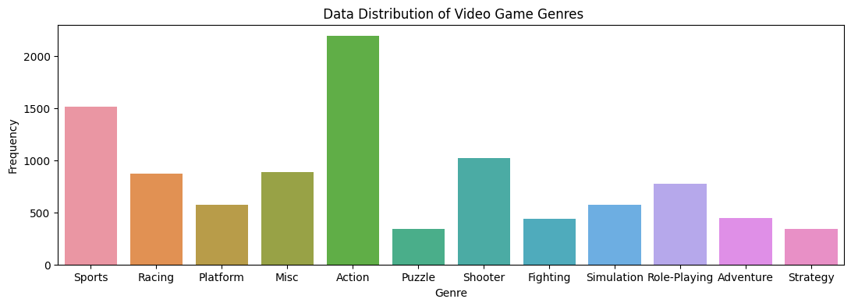
Exploratory Data Analysis & Preprocessing (1/4)
Checked missing values for each relevant feature in the dataset
Missing-data imputation on critic scores and user scores
The imputed data is the mean value of the respective feature within a particular genre, e.g., the average of all user scores under the 'Action' category.
Removal of missing data for other features
Analyzed data distribution for each feature by leveraging Matplotlib & Seaborn packages

Slide 11
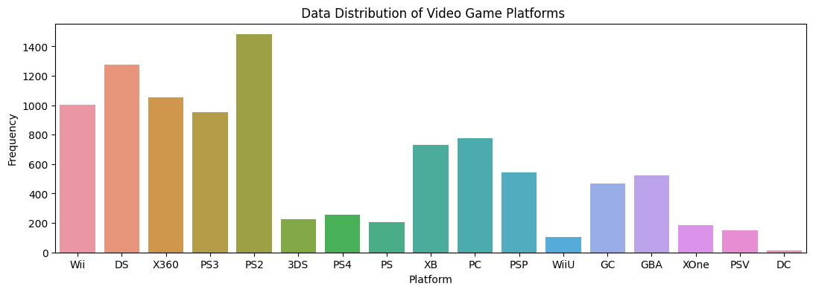
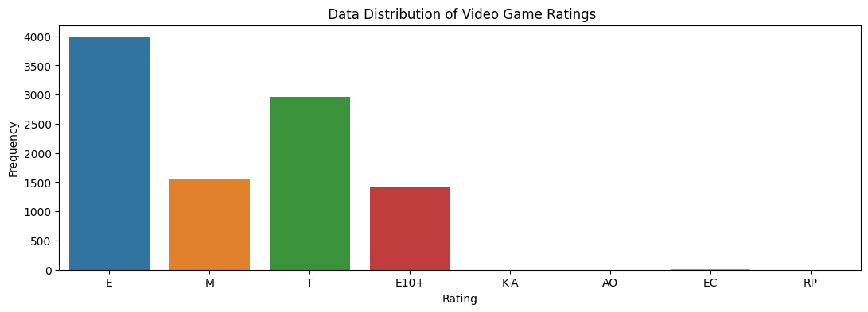
Exploratory Data Analysis & Preprocessing (2/4)
There is a scarcity of data available for certain platforms such as DC, and ratings such as 'K-A', 'AO’, ‘EC’ and 'RP’. If a game falls under these platforms or ratings, the recommendations might also include games from other platforms or ratings that share similar features based on various factors used in distance calculation.

Slide 12
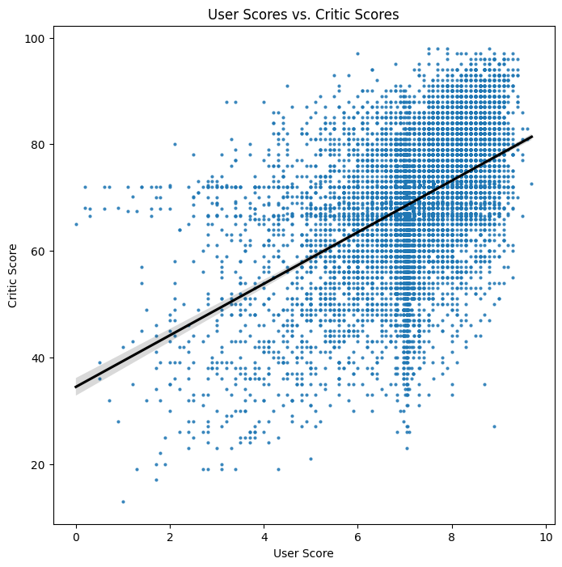
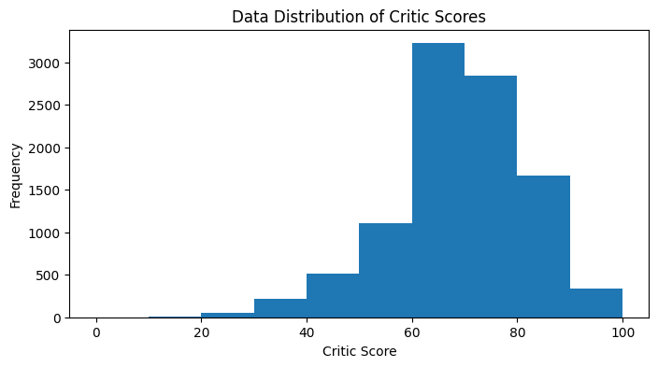
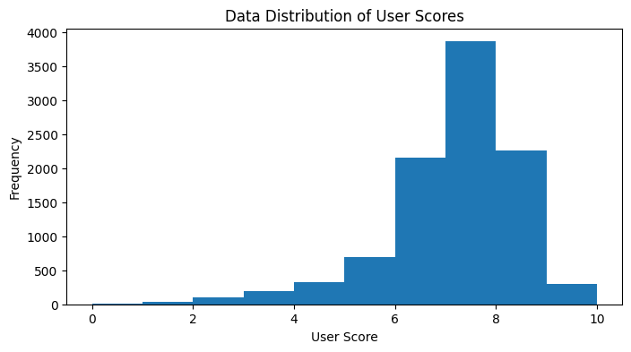
Exploratory Data Analysis & Preprocessing (3/4)

Slide 13
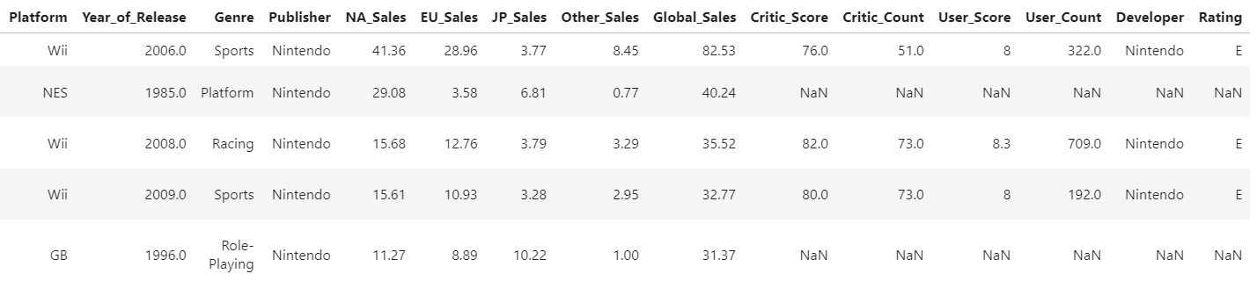
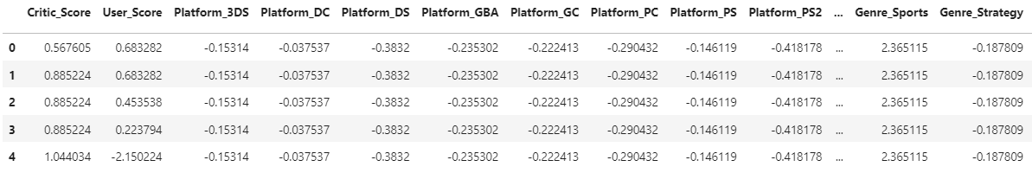
Exploratory Data Analysis & Preprocessing (4/4)
Converted categorical features to dummy indicators where the value 0 (representing No) or 1 (representing Yes)
Transformed numerical features to a standardized form for features to have similar scale
Raw Data
Data
Preprocessing
Clean Data

Slide 14
Model Creation: Recommendation Model (KNN)
Model Architecture
Details
Python
Model
K-Nearest Neighbor (KNN) from Python scikit-learn is used to create the model
KNN is a supervised machine learning algorithm that employs distance calculation to determine the similarity between data points
Value of K determines the number of neighboring data points to be considered during classification or regression
Model Development
Clean Data
Sklearn
TrainTest Split
Training
Data
Testing
Data
Complexity
Complexity on the user input requirement is high, as the user needs to provide all 10 features that the model is trained on for the recommendations to be generated
K-Nearest Neighbors
metric: Euclidean similarity
Resolution
Selecting a different model in order to get a better user experience with less input values
Model Deployment
Input
Recommendation Model
Output

Slide 15
Model Creation: Recommendation Model (NN)
Model Architecture
Details
Python
Model
Nearest Neighbor (NN) from Python scikit-learn is used to build the model
NN is an unsupervised machine learning algorithm that uses distance computation to calculate data point’s similarity
Cosine similarity is utilized for distance metric of NN
Model Development
Clean Data
Sklearn
Complexity
Games that are available on multiple platforms receive more than ten results for recommendations
Nearest Neighbours
metric: cosine similarity
Model Deployment
Resolution
Added an optional parameter platform to limit the results
For multiple platforms: Merge all outcomes, arrange them in ascending order, and select the first ten with the least distance calculation
Input
Recommendation Model
Output

Slide 16

Model Evaluation (KNN and NN Comparison)
K-Nearest Neighbors
(Supervised Algorithm)
Nearest Neighbor
(Unsupervised Algorithm)
Usage
Better choice if the dataset is large and complex, and the accuracy of the recommendations is crucial
More suitable for a smaller and simpler dataset where a lightweight algorithm is preferred
No training is required
User Efficiency
Input is the set of features that was used in the model training to properly classify the game and get recommendations
Input is the game title and platform (optional) – the recommended games have already been pre-calculated for each game
Conclusion:
Nearest Neighbor algorithm was identified as a more appropriate choice for the recommendation model aimed at providing video game suggestions based on the title and platform (optional) as input.
The simplicity and straightforwardness of the input features were the determining factors, making a full-fledged classification algorithm unnecessary.
*

Slide 17

Video Game Recommendation System (Prototype)

Slide 18
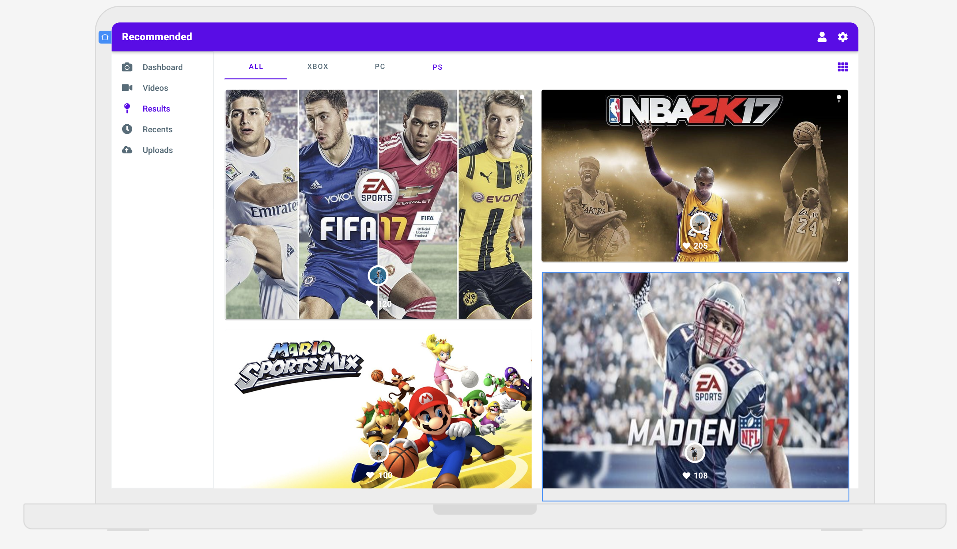
Video Game Recommendation System (Prototype)

Slide 19

Video Game Recommendation System (Prototype)

Slide 20
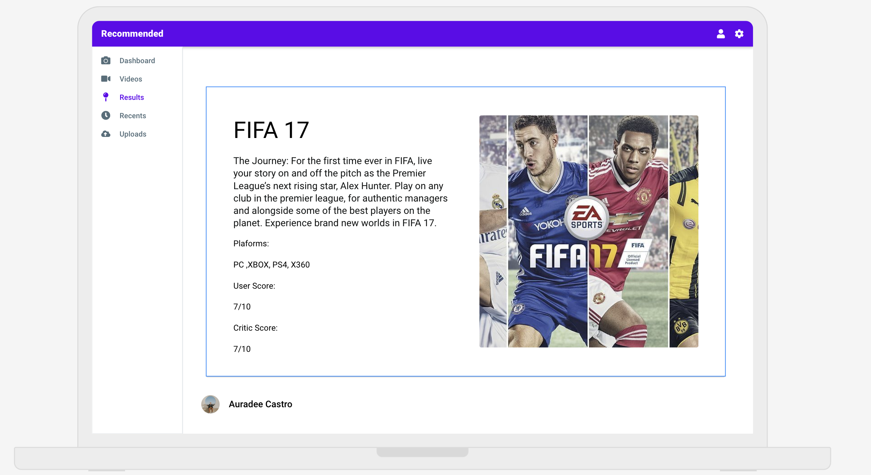
Video Game Recommendation System (Prototype)

Slide 21
Conclusion
Sourced the data from Kaggle then preprocessed it
Conducted Market Trend Analysis by leveraging PowerBI
Moved forward with the EDAs
Researched appropriate algorithm for the recommendation model
Selected NearestNeighbour unsupervised learning model as more appropriate model for the recommendation system
Developed a UI prototype for the recommendation model for demo purposes

Slide 22
References
Kirubi, Rush. (2017). Video Game Sales with Ratings. Kaggle. https://www.kaggle.com/datasets/rush4ratio/video-game-sales-with-ratings
VGChartz. https://www.vgchartz.com/gamedb/
Kharwal, Aman. (2021, January 17). Book Recommendation System. The Clever Programmer. https://thecleverprogrammer.com/2021/01/17/book-recommendation-system/
Vijay, Harsh. (2020 April 11). Recommendation System using KNN. Auriga. https://www.aurigait.com/blog/recommendation-system-using-knn/
Makwana, Aman. (2022, December 26). Understanding Recommendation System and KNN with Project – Book Recommendation System. Medium. https://aman-makwana101932.medium.com/understanding-recommendation-system-and-knn-with-project-book-recommendation-system-c648e47ff4f6
Varun. (2020 September 27). Cosine similarity: How does it measure the similarity, Maths behind and usage in Python. Toward Data Science. https://towardsdatascience.com/cosine-similarity-how-does-it-measure-the-similarity-maths-behind-and-usage-in-python-50ad30aad7db

